Slide 1
Kickstarter Crowdfunding Analysis

Slide 2

Team 4
Group Members :
Sakshi Thakare
Soham Jadhav
Naveen
Himani Dhale
Mansi Zende

Slide 3

INTRODUCTION
Crowdfunding is the practice of funding a project or venture by raising small amounts of money from a large number of people, typically via the Internet.
Crowdfunding is a form of crowdsourcing and alternative finance. In 2015, over US$34 billion was raised worldwide by crowdfunding.
Backing a project is more than just giving someone
money. It's supporting their dream to create something
that they want to see exist in the world.

Slide 4
Data Understanding
The data was given in 4 different parts i.e is Catergory , Creator, Location , Project.
For creating calender Table we have taken Created_at Colunm from project Table where created_at contain dates in epoch format which we converted into human readable.
We made relationship between the tables through power query editor is fact table.
The data contain 3,65,892 observations.

Slide 5
KPI’s
Total Number of Projects based on outcome
Total Number of Projects based on Locations
Total Number of Projects based on Category
Total Number of Projects created by Year , Quarter , Month
Amount Raised
Number of Backers
Avg Number of Days for successful projects.
Based on Number of Backers
Based on Amount Raised.
Percentage of Successful Projects by Category
Percentage of Successful Projects by Year , Month etc..
Percentage of Successful projects by Goal Range

Slide 6
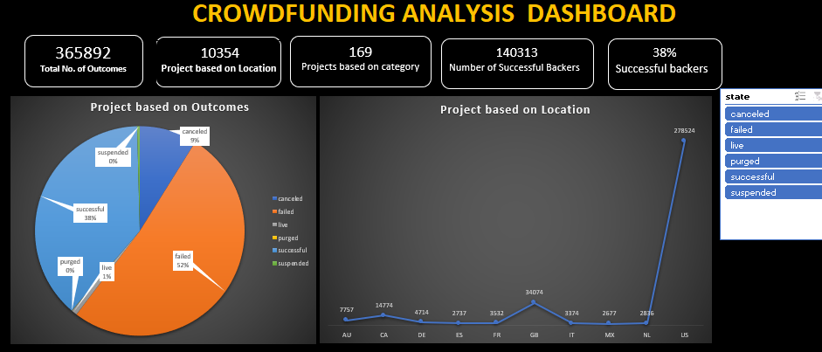
Excel Dashboard 1

Slide 7
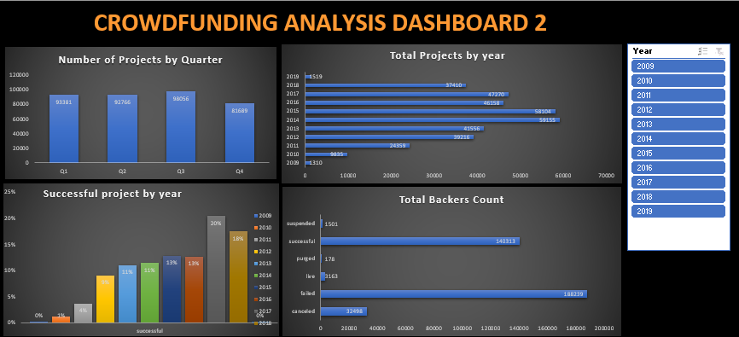

Slide 8
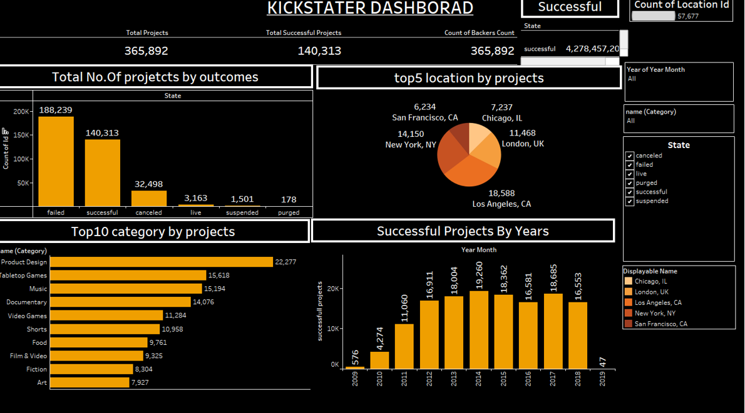
Tableau Dashboard 1

Slide 9
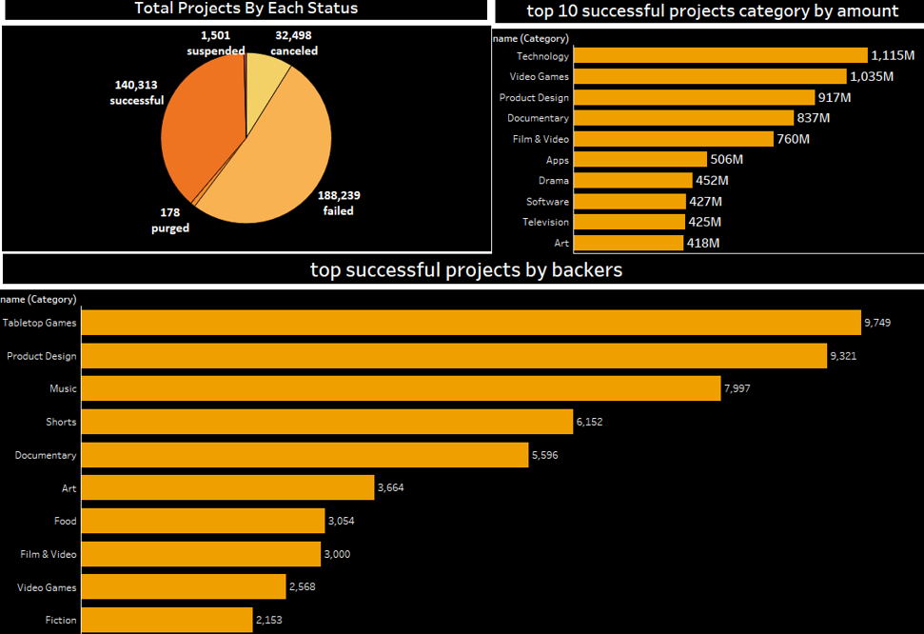
Tableau Dashboard 2

Slide 10

MySQL
We have Imported 4 tables in MySQL Workbench.
Created calendar table by both procedure and views method.
The project file contains the 'created_at' timestamp in epoch time which we converted into human-readable format.
Executed KPIs.

Slide 11
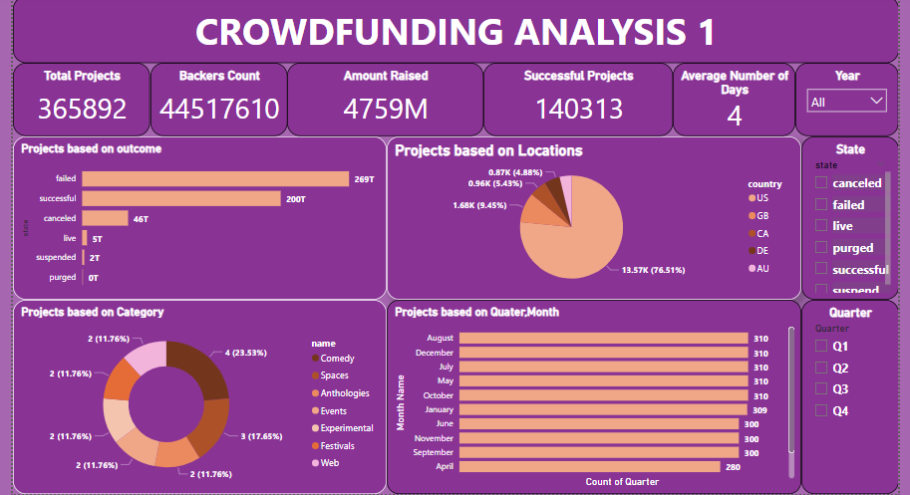
Power BI DASHBOARD 1

Slide 12
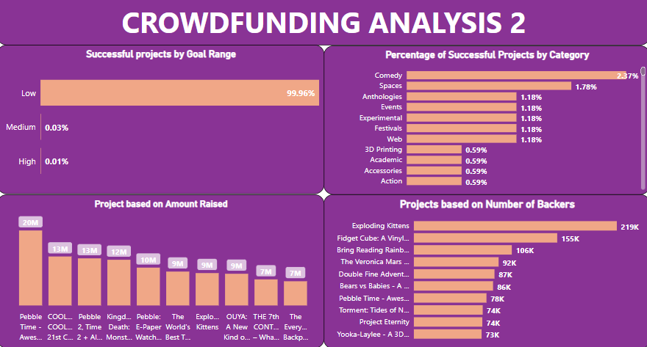
Power BI DASHBOARD 2

Slide 13
Conclusion
Kickstarter is a vibrant platform where thousands of independent creators bring their creative projects to life. Filmmakers, musicians, artists, and designers enjoy complete autonomy and responsibility over their projects, investing significant time and effort into crafting compelling campaigns. These creators set funding goals and deadlines, inviting people to pledge their support. The 'all-or-nothing' funding model ensures that only fully funded projects proceed. Backers play a pivotal role by supporting projects they believe in and receiving unique rewards in return.
A Significant number of backers rally around their friend’s projects or support individuals they have long admired. These connections play a pivotal role in driving crowdfunding efforts.
Many backers are inspired by innovative and novel ideas presented in Kickstarter campaigns. The allure of contributing to something new and exciting drives their support.
The project's rewards system is a major motivating factor for backers. These rewards often include unique items, limited editions, or custom experiences related to the project. Backers are enticed by the prospect of receiving something tangible in return for their support.

Slide 14
THANK YOU

